Slide 1
Higher Biology
Metabolism & Enzymes
Mr G R Davidson

Slide 2
Cell Metabolism
Cell metabolism is the name given to the many thousands of chemical reactions which occur inside cells.
They form a highly complex network of pathways which are all controlled by enzymes.
P
Enzyme p
Q
Enzyme q
R
Enzyme r
S

Slide 3
Cell Metabolism
There are 2 kinds of metabolic pathways:
Catabolic pathways break down large complex molecules usually releasing energy, e.g. aerobic respiration.
Anabolic pathways are biosynthetic which involves the building of large complex molecules from simple molecules requiring energy, e.g. protein synthesis.

Slide 4
Cell Metabolism
Catabolism
Energy

Slide 5
Cell Metabolism
Anabolism
Energy

Slide 6
Cell Metabolism
All metabolic pathways are controlled by enzymes.
They often contain reversible as well as irreversible reactions.
Some reactions may even contain an alternative route which can allow one or more steps in a reaction to be bypassed.

Slide 7
Cell Metabolism
P
P
Enzyme c
Enzyme p
Enzyme p
Q
Q
Alternative
Enzyme q
Enzyme q
fails to work
R
R
Enzyme z
Enzyme r
Enzyme r
S
S

Slide 8
Membranes
The cell membrane or plasma membrane is responsible for the entry and exit of materials to and from the cell.
It consists of proteins and phospholipids.
The phospholipids form a double layer with their hydrophilic heads and their hydrophobic tails.

Slide 9
Membranes
Extracellular
Phospholipid
Hydrophilic head
Hydrophobic tail
Intracellular

Slide 10
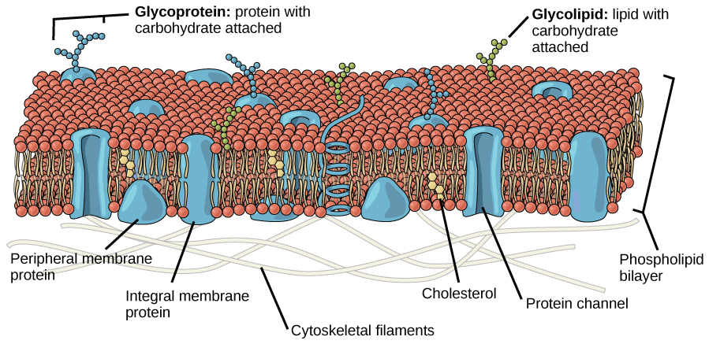
Plasma Membrane

Slide 11
Membranes
The phospholipids are in constant motion, giving the membrane a fluidity.
The proteins form a mosaic-like pattern, scattered throughout the phospholipids, hence the “fluid mosaic model” name.
The proteins have different functions such as ‘channel forming’, ‘pumps’, etc..

Slide 12
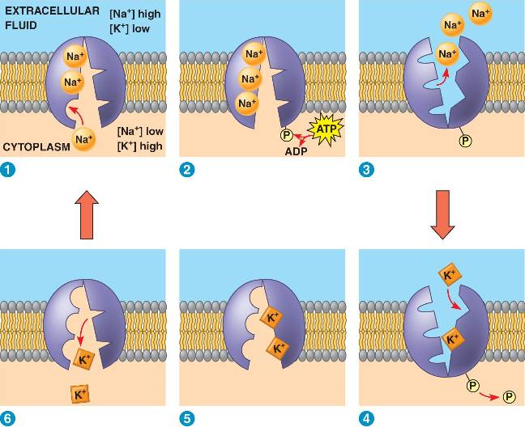
Sodium/Potassium Pump

Slide 13
Membranes
Some of these proteins act as carrier molecules and transport specific molecules against the concentration gradient by active transport.
This process requires energy.
The sodium/potassium pump in cell membranes is a good example, where the carrier proteins transport sodium out as well as transporting potassium in.

Slide 14
Membrane Proteins
Some proteins in the membrane are enzymes and some of these are essential for the metabolic processes occurring in the cell.
Some of the cell organelles have folded inner membranes which provide a very large surface area for these enzymes to work.

Slide 15
Enzymes
Enzymes are biological catalysts which speed up the rate of reactions by lowering the ‘activation energy’ required to start the reaction.
If no enzyme is present the activation energy is much higher, and in some cases heat can provide that energy, but this is usually not the case in living organisms.

Slide 16
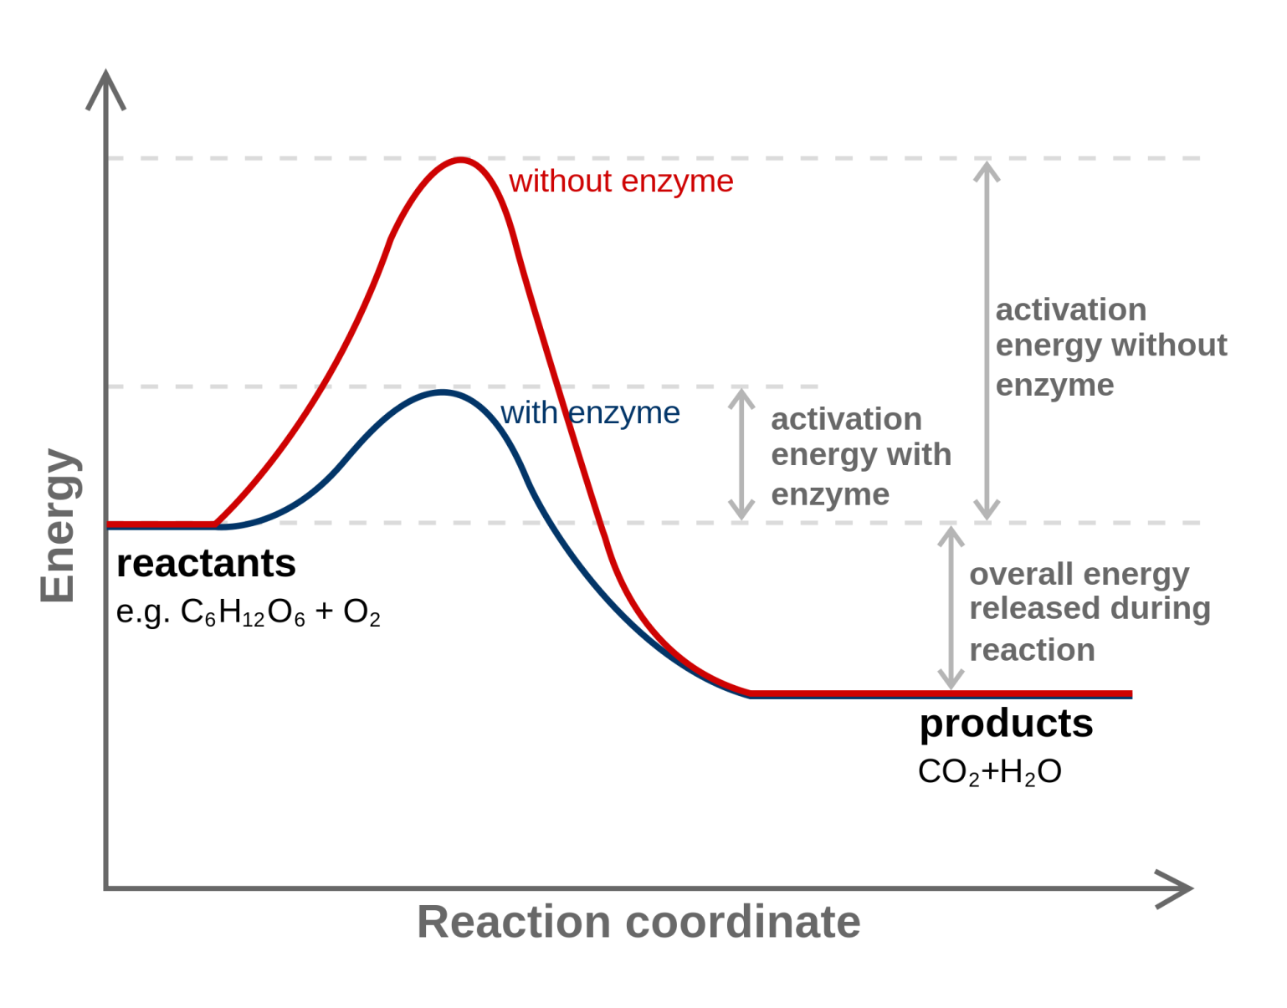
Enzymes

Slide 17
Enzymes
All enzymes are made of protein and somewhere on the surface of the protein is an area called the ‘active site’ which has a specific shape.
The substrate of the reaction fits into this shape and the activation energy can then be lowered resulting in the reaction taking place.

Slide 18
Enzymes
There are some enzymes, however, which alter their shape slightly to suit the substrate.
The active site is ‘dynamic’ and we call this induced fit.

Slide 19
Enzymes
This also brings about a lowering of the activation energy.
Once the product is produced, moves away from the enzyme and the active site can return to its original shape.
Enzymes can also be responsible for the orientation of the substrates in order that they are lined up correctly for the reaction to occur.

Slide 20
Enzymes
There are occasions when enzymes are grouped together to perform multiple reactions in the correct order.
We call these multiple-enzyme complexes.
e.g. in respiration the steps of the reaction must proceed in the correct sequence.

Slide 21
Enzymes
There are a number of things which can speed up or slow down an enzyme-controlled reaction such as:
Temperature
pH
Substrate concentration
Inhibitors
We call these limiting factors.

Slide 22
Enzymes
If we keep increasing the concentration of substrate, we are effectively increasing the numbers of molecules of substrate.
If there are active sites available for this increased number of substrate molecules, then the number broken down will increase.

Slide 23
Enzymes
This will continue to increase until all the active sites become full and at this point the enzyme concentration becomes the limiting factor because there are no active sites left to be filled.

Slide 24
Enzyme Inhibitors
Inhibitors are substances which can slow down the rate of an enzyme and they are split into 2 main types:
Competitive inhibitors
Non-competitive inhibitors

Slide 25
Competitive Inhibitors
Competitive inhibitors have a similar shape to that of the substrate and so they also fit the enzyme’s active site.
If the inhibitor joins the enzyme, this prevents the substrate from doing so, and this therefore reduces the number of substrate molecules being used by the enzyme.

Slide 26
Non-competitive Inhibitors
This type of inhibitor doesn’t interfere with the active site.
Instead, it binds to another part of the enzyme but results in the shape of the enzyme being altered to change the shape of the active site.

Slide 27
Non-competitive Inhibitors
The substrate can now no longer fit the enzyme’s active site and therefore the reaction cannot take place.
Heavy metals like lead, silver, etc., are examples of non-competitive inhibitors

Slide 28
Feedback Inhibition
Feedback inhibition is another type of inhibition and occurs when the products of the reaction end up inhibiting the reaction, or a previous reaction in a series of reactions.

Slide 29
Switching Genes on and off
There are some metabolic pathways which are only required under certain circumstances.
In this case the genes which code for the enzymes which drive the reaction can be switched on and off.
This prevents a waste of valuable resources.

Slide 30
Lac Operon of E. coli
Escherichia coli (E. coli) is a bacterium which uses lactose as an energy source.
It can break down the lactose into glucose and galactose in order to use the glucose in cellular respiration.
Lactose is broken down to glucose and galactose by an enzyme called β-galactosidase.

Slide 31
Lac Operon of E. coli
However, the β-galactosidase is only produced by the E. coli when lactose is present.
When there is no lactose, no enzyme is produced.

Slide 32
Lac Operon of E. coli
This would suggest that it is the presence, or absence, of lactose which is responsible for the switching on, or the switching off, of the gene which codes for the enzyme.
The process of switching on the gene is called enzyme induction.

Slide 33
Enzyme Induction
To explain this process, the Operon Hypothesis has been put forward.
An operon is one or more structural genes and a neighbouring operator gene which can activate the structural gene.

Slide 34
Enzyme Induction
The structural gene is the DNA code for the specific enzyme.
The operator gene switches on and off depending on a repressor molecule which is coded for by a regulator gene found further along the DNA chain.

Slide 35
Effect of repressor in absence of lactose
Regulator
gene
Operator
gene
Structural
gene
OPERON
DNA chain
Structural gene
‘switched off’
Repressor combines
with operator
No β-galactosidase
produced
Regulator gene
codes for the
repressor molecule

Slide 36
Effect of repressor in presence of lactose
Regulator
gene
Operator
gene
Structural gene (which codes
for the protein)
OPERON
DNA chain
Operator
free
Successful transcription
to form β-galactosidase
Transcription and
translation to form
repressor protein molecule
Some lactose
combines with
repressor
Enzyme digests
lactose until
supply runs
out
+

Slide 37
Gene Products
We have seen how genes can be controlled to produce enzymes.
If a gene produces an enzyme, it can have wide ranging effects on cells and on the organism.
A mutation in a gene responsible for the production of an enzyme may result in non-production of the enzyme so the reaction it controls cannot take place.

Slide 38
Gene Products
A mutation in humans which results in the non-production of the enzyme phenylalanine hydroxylase causes a condition known as phenylketonuria (PKU).
This condition results in severe mental retardation and all new born babies are tested to ensure they don’t suffer from this condition.

